Slide 1
CDS505
DATA VISUALISATION & VISUAL ANALYTICS
Project：House Rent Analysis for India
Sem 1 2023-2024
ZHANG TINGTING| 22203272
21 November 2024

Slide 2
Table of contents
01
02
03
04
Abstract & Domain Background
Data and Task Abstraction
Methods and Analysis
Discussion and Conclusion

Slide 3
01
Abstract & Domain Background

Slide 4
Why Analyze the Indian Rental Market
As the Indian economy grows and the rate of urbanization increases, activity in the real estate sector is also increasing. Forecasting rental market trends has become an important topic for the real estate industry and investors.
By collecting and analyzing rental forecast data, it aims to provide valuable insights into future rental potential to property developers, landlords and tenants.

Slide 5
Domain Background
Economic growth and accelerated urbanization have led to a surge in demand for housing, especially in large cities such as Mumbai, where prices have skyrocketed and become unaffordable. India's complex land system, with 70 per cent private ownership, makes large-scale development difficult. "According to the Human Rights Measurement Initiative, India has achieved 60.9 per cent of the theoretically achievable goal of guaranteeing its citizens' basic right to housing. Renting has become a temporary solution, but the tension between supply and demand has increased.

Slide 6
02
Data and Task Abstraction

Slide 7
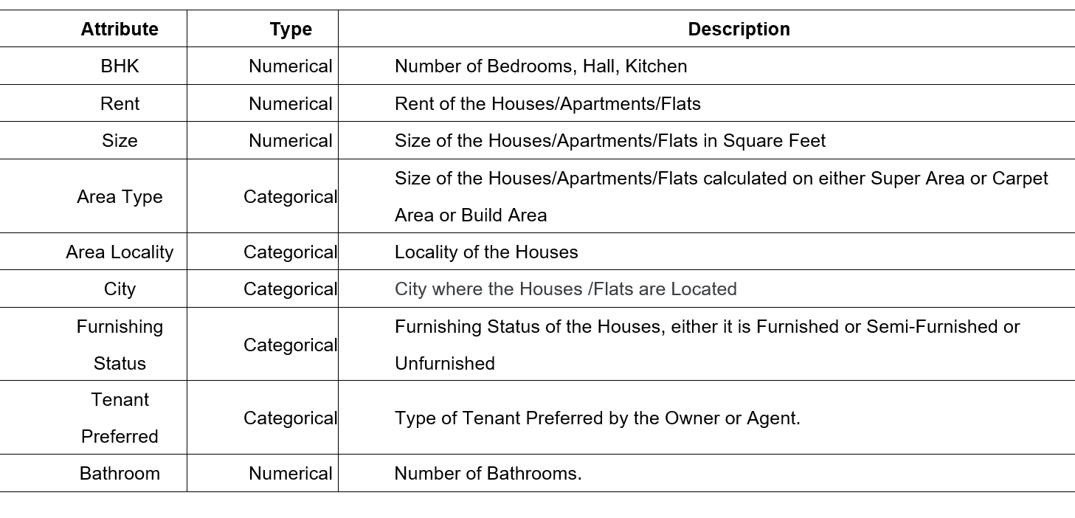
Dataset description

Slide 8
Task Abstraction
Market Trend Analysis
Rent Forecasting
Landlord Preference and Strategy Analysis
Tenant Preference Analysis

Slide 9
03
Methods and Analysis

Slide 10
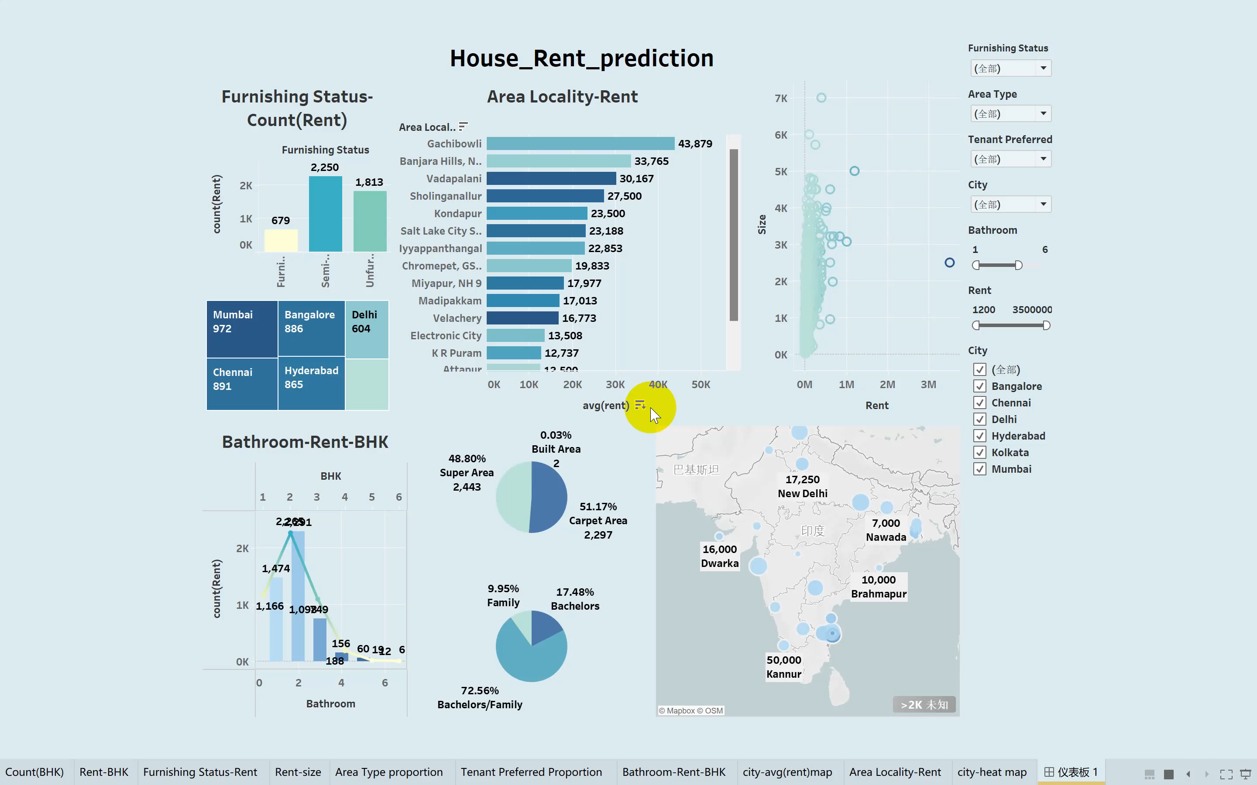
Tool : Tableau

Slide 11
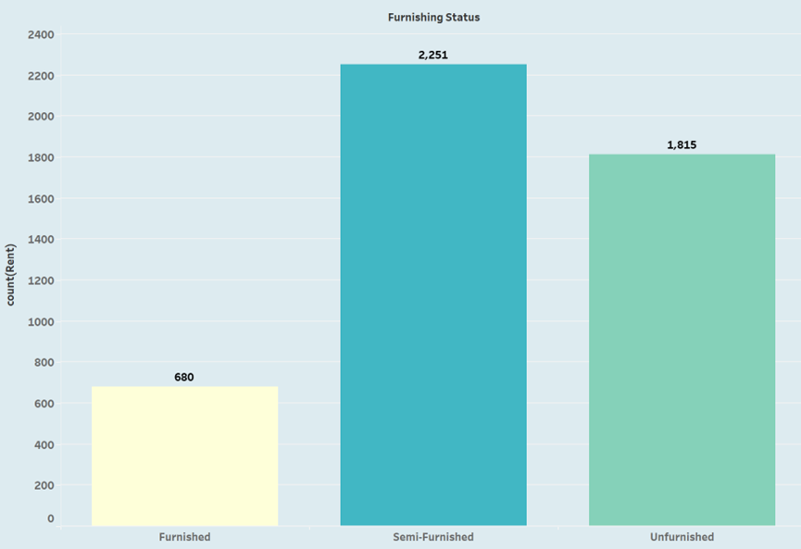
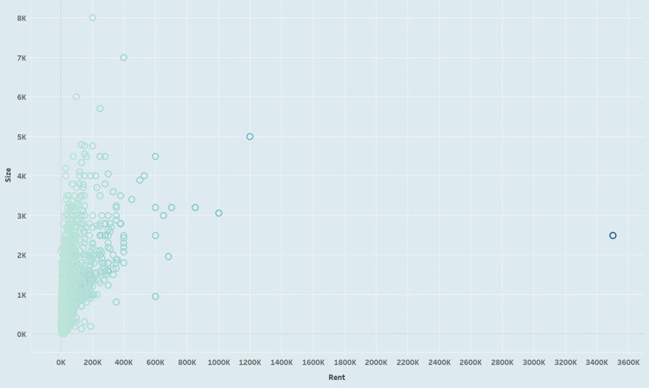
Methods And Tools
Bar Charts
Scatter Plots

Slide 12
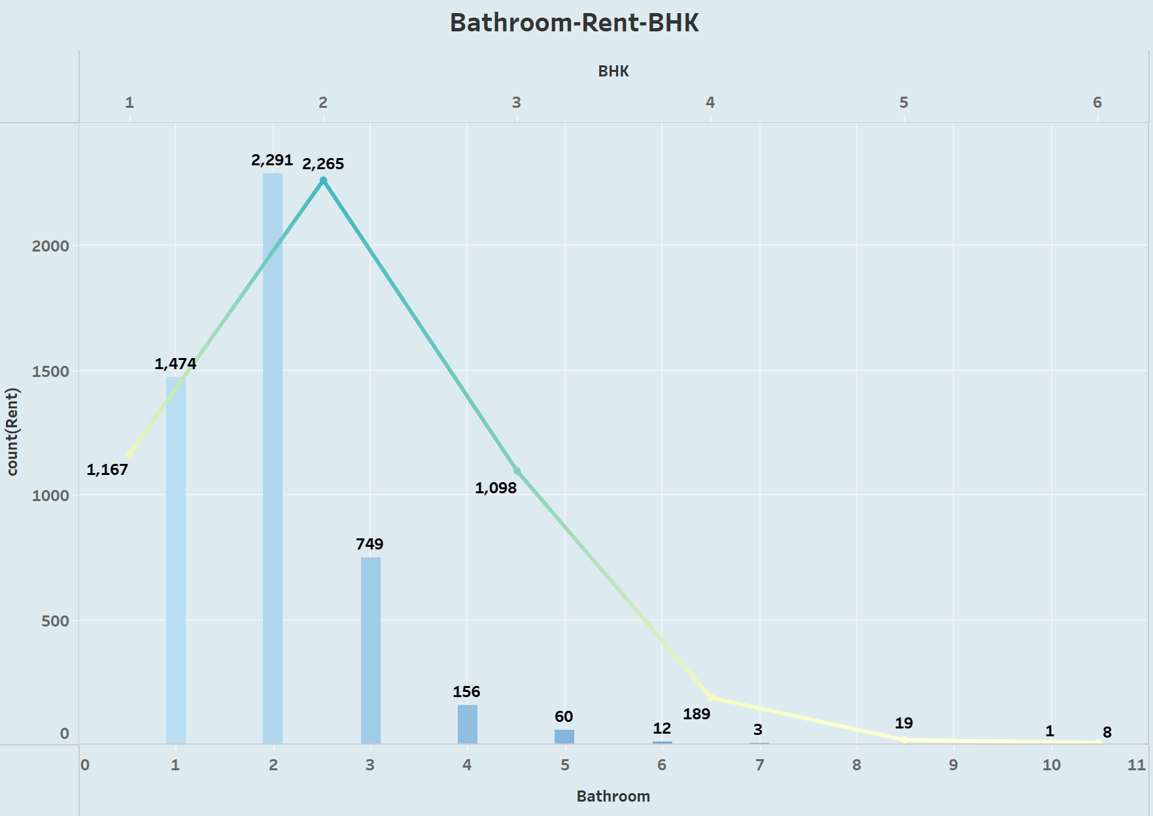
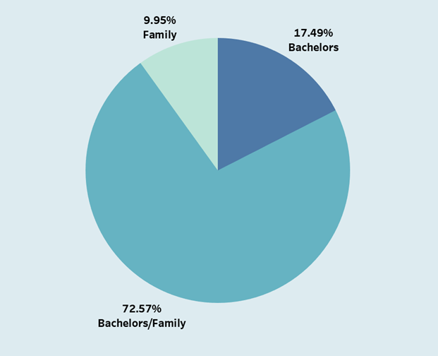
Methods And Tools
Line chart
Pie Charts

Slide 13
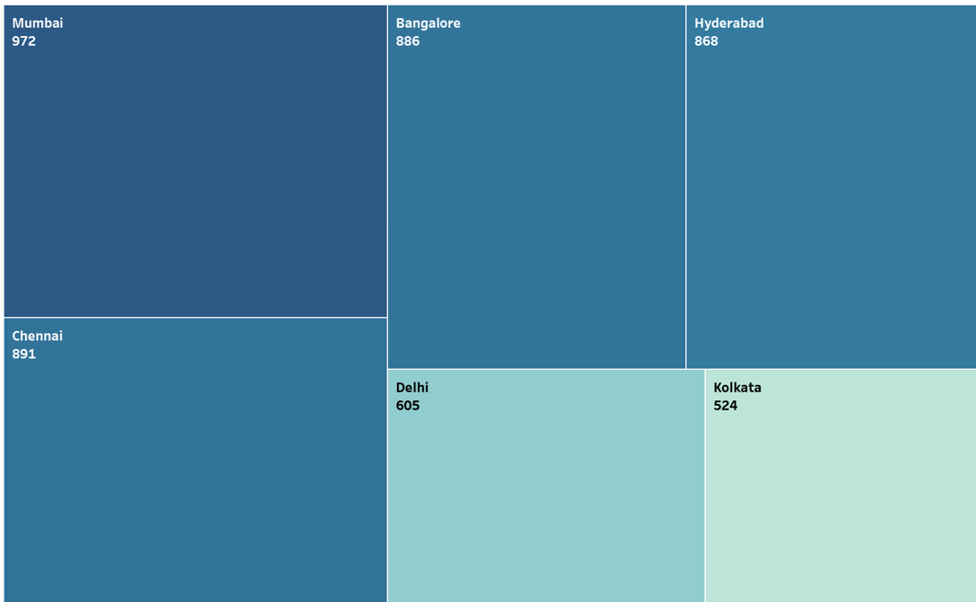
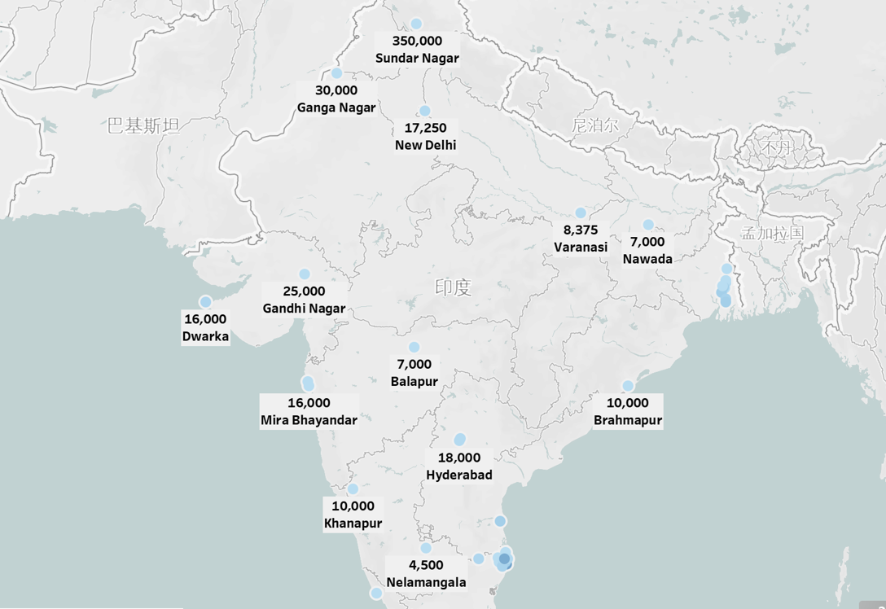
Methods And Tools
Rectangular tree diagram
Map

Slide 14
04
Discussion and Conclusion

Slide 15
Discussion
Conclusion
This dataset does not fully reflect trends in the Indian rental market, and market complexities such as political stability, economic growth rates, and socio-cultural aspects may also have a profound impact on the results. To improve the accuracy of the analysis, there are plans to expand the dataset in the future to include more geographic and economic indicators, as well as a refinement of housing characteristics.
Through the skillful use of Tableau tools, we reveal the fundamental characteristics of the market and provide recommendations for future trends. Rent levels are a central issue in the market and are influenced by a number of factors such as location and building differences. At the same time, the size and layout of the building play an important role in rent setting. The condition of furnishings and the configuration of decorations also influence tenant choice

Slide 16
Thanks!

